Slide 1




Cat Tales:
the social side of an international Citizen Science project exploring the movement and management of cats
Dr. Heidy Kikillus
ERA 2016 Hamilton
November 2016

Slide 2
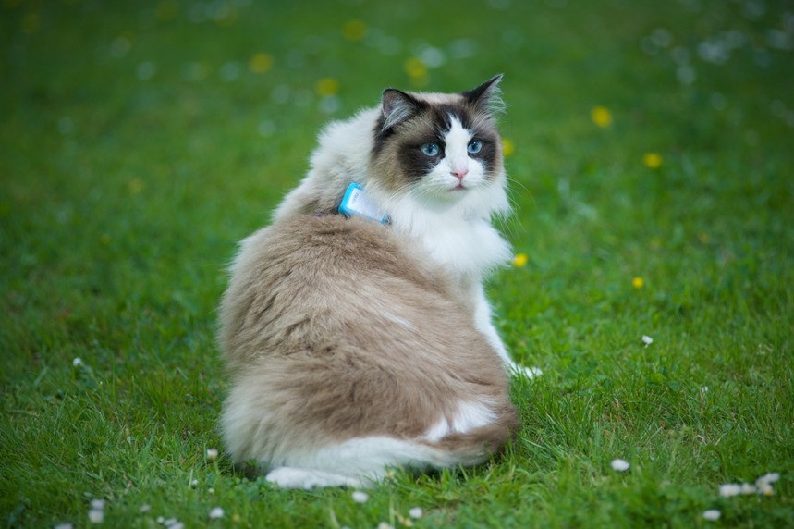
Cat Tracker
Involving the public
  Cat stories
  Public perceptions
Investigating cat movements
  Where?
  When?

Slide 3
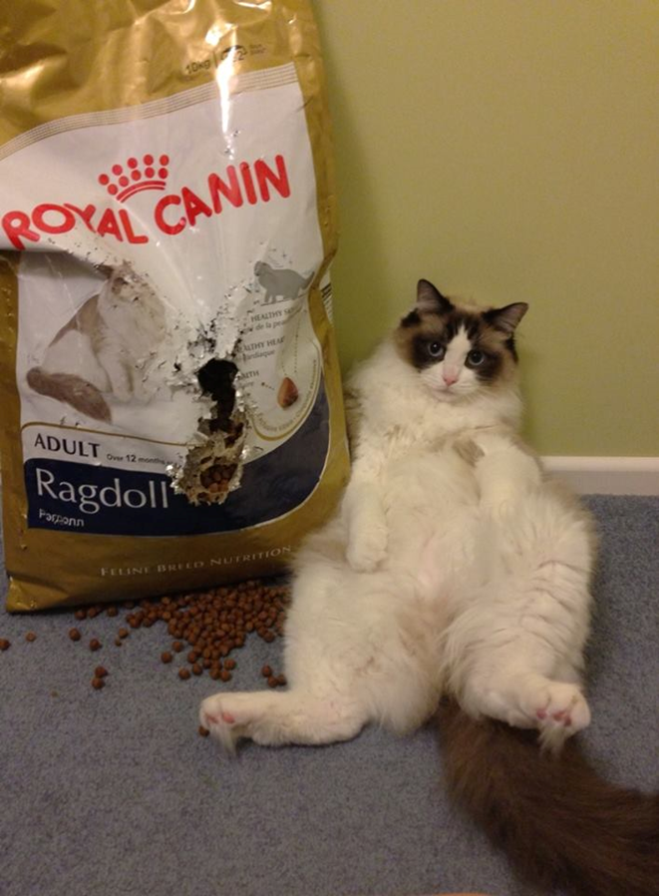
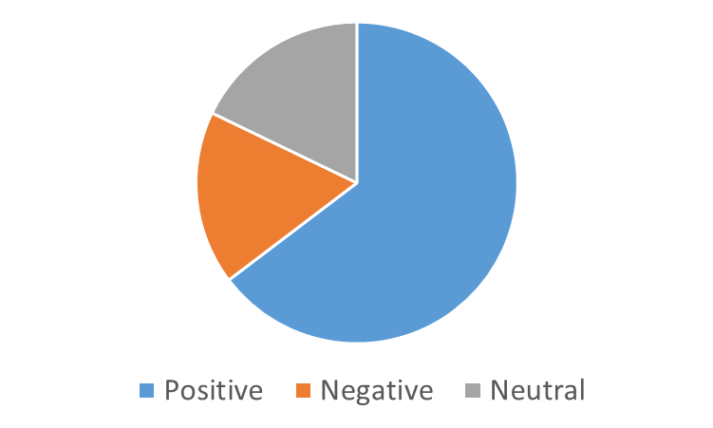
Tell us your cat story…
1,000+ stories
Numerous themes

Slide 4
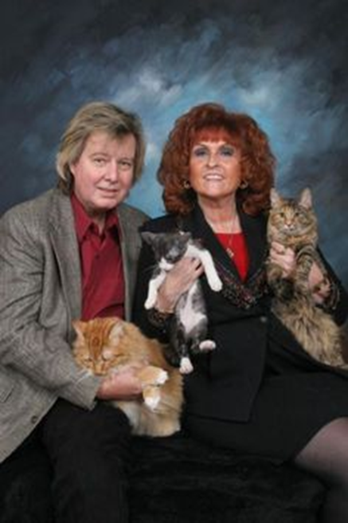
Theme #1: Cats are a much loved member of the family
“All our animals get Xmas presents as well and we celebrate their birthdays”
“She makes our house happy and is a member of our family”
“I loved him so very much, he was more like a brother than just a cat”

Slide 5
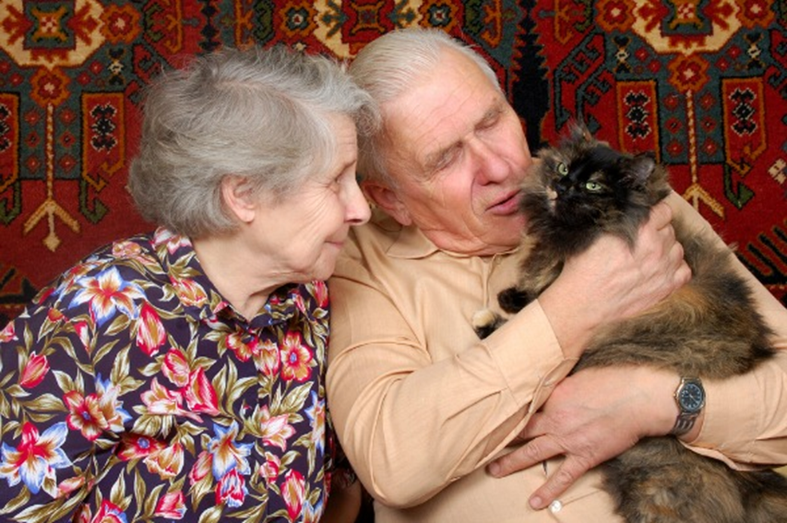
Theme #2: Cats are therapeutic
“…their cats are hugely important for good mental health and giving a reason to live, the benefit of having cats as friends outweighs the occasional trouble they cause”

Slide 6
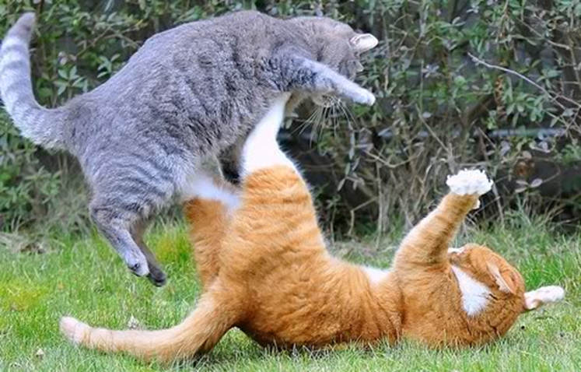
Theme #3: Cats are annoying
“There is a cat version of Fight Club that somehow finishes into an orgy about every night on my lawn”

Slide 7
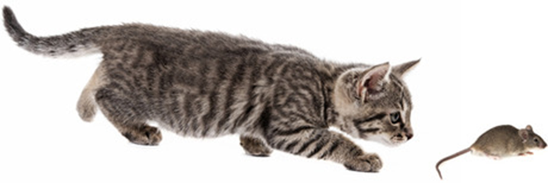
Theme #4: Cats control pests
“When Hartley catches and kills a rat in the middle of the night, he brings it to the same place beside my wardrobe, making the weird miaow, and he only eats its tail which sounds very crunchy when you're listening to it in the dark”

Slide 8
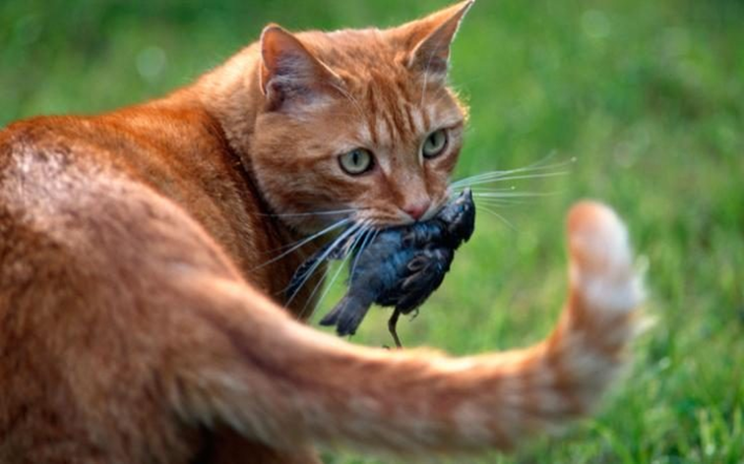
Theme #5: Cat owners need to be more responsible
“I like cats but I would like it more if their owners didn't just leave them strolling everywhere”
“I love my cats, but our wildlife is more important”

Slide 9
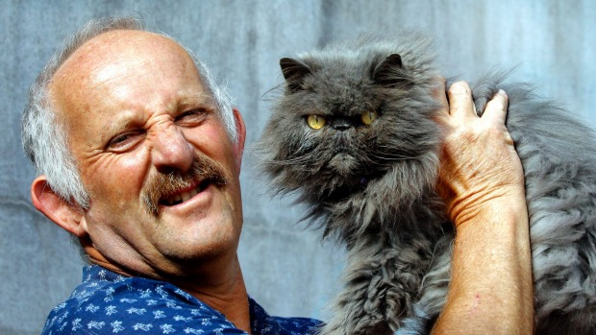
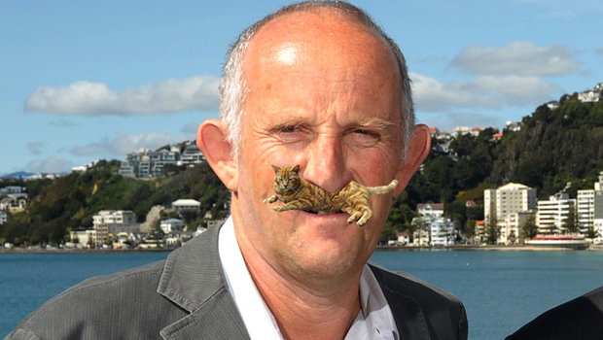
Theme #6: Gareth Morgan
“[Expletive noun]s like gareth morgan is a psychopath and should be shot. His attitudes about other living creatures is sickening”.
“…Back when Gareth Morgan first announced his opinions I had begun to learn about the issues myself but still thought his opinions to be ridiculous. Now in many ways I do support him but it is still very situation dependent”.
“I support Gareth Morgans stance, but I wouldn't want to get rid of them from NZ entirely, cats offer a lot especially to young children and the elderly”.
“I support Gareth Morgan in regard to cats. He deserves a medal or a knighthood”.

Slide 10
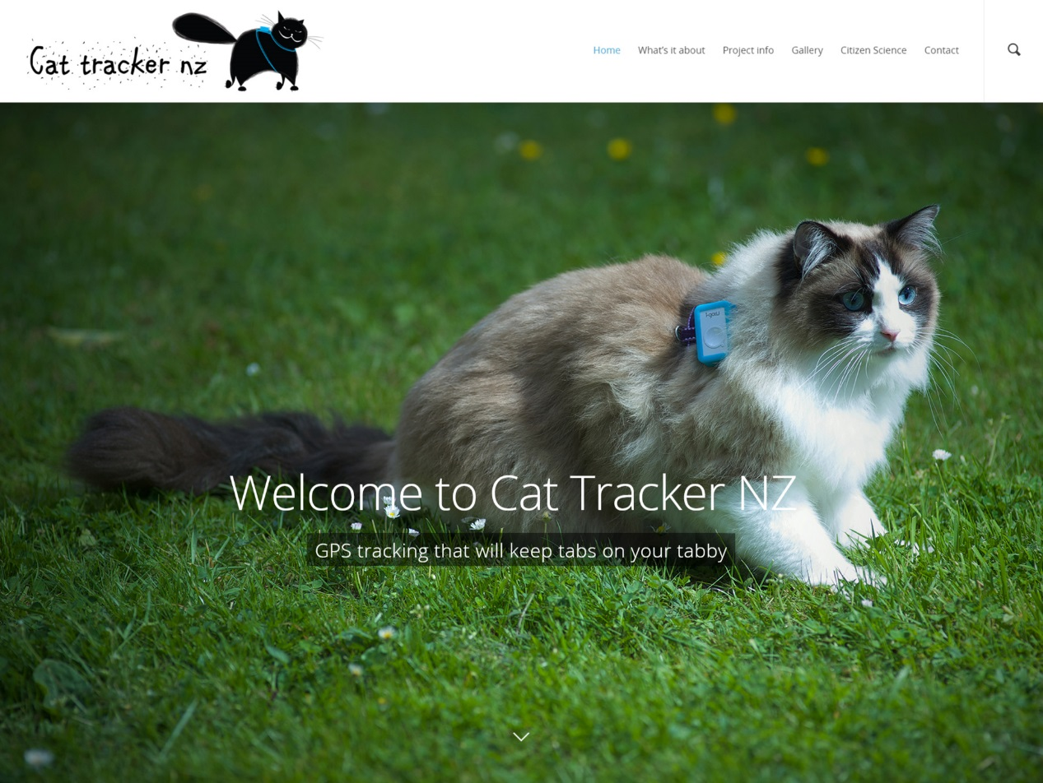
www.cattracker.nz

Slide 11
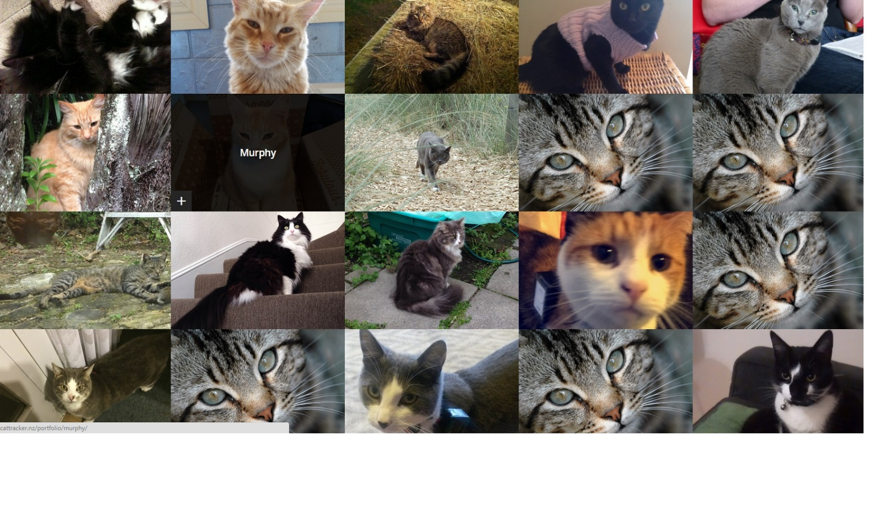
Meet the Cats

Slide 12
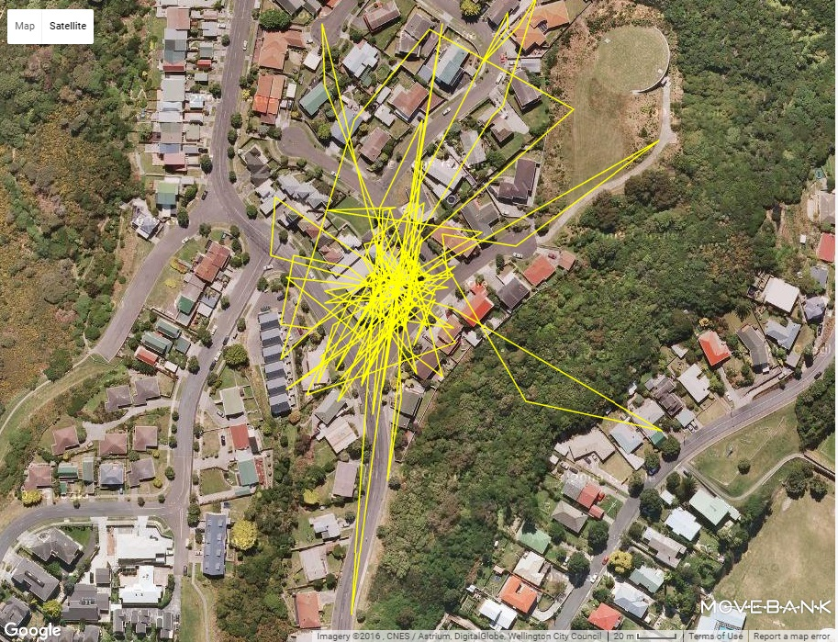
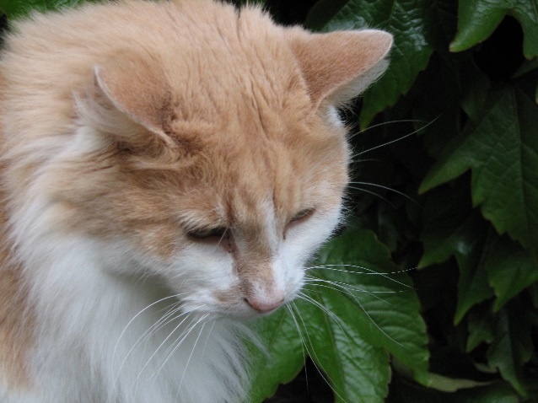

Slide 13
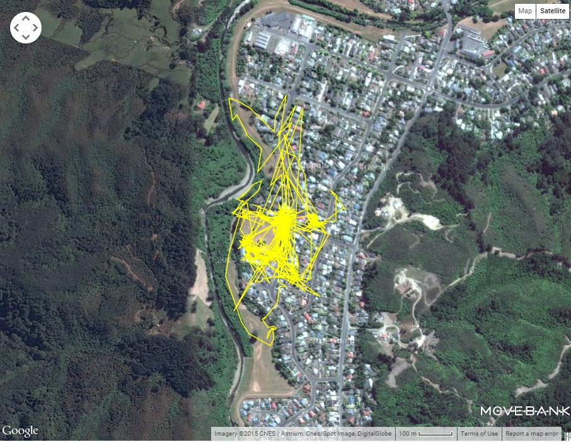
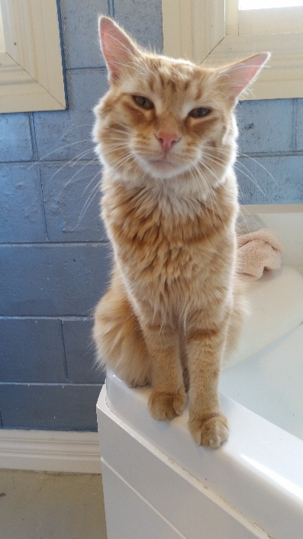

Slide 14
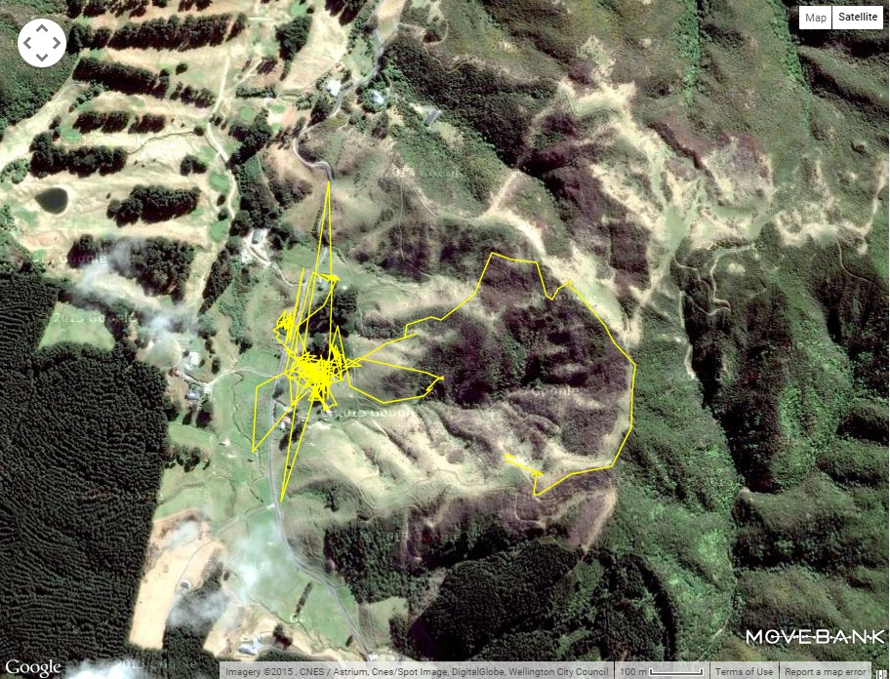
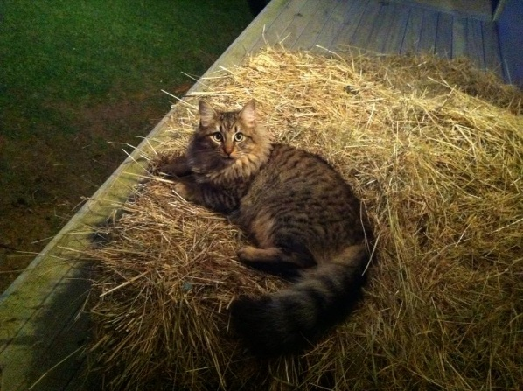

Slide 15
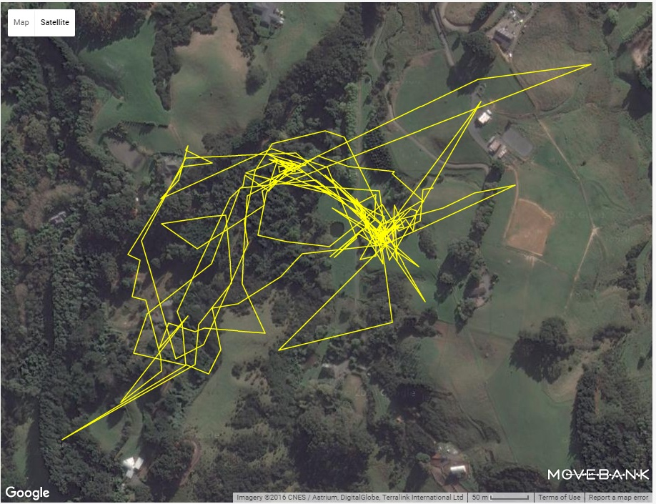
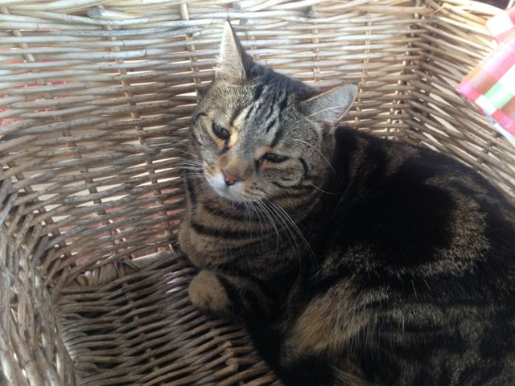

Slide 16
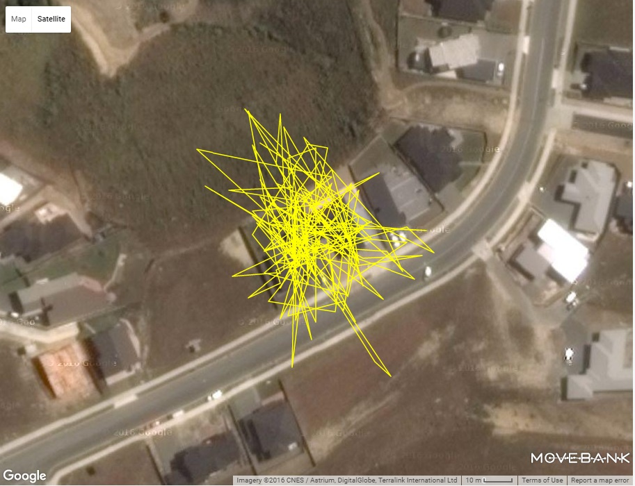
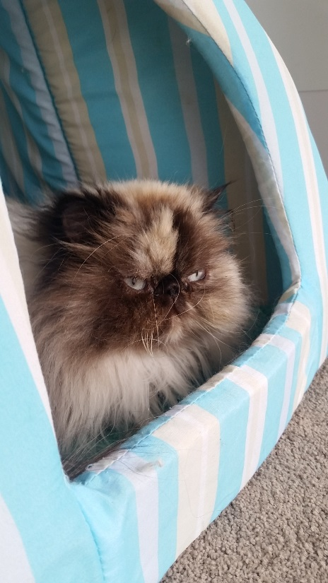
“I would describe Coco as extremely lazy”.

Slide 17
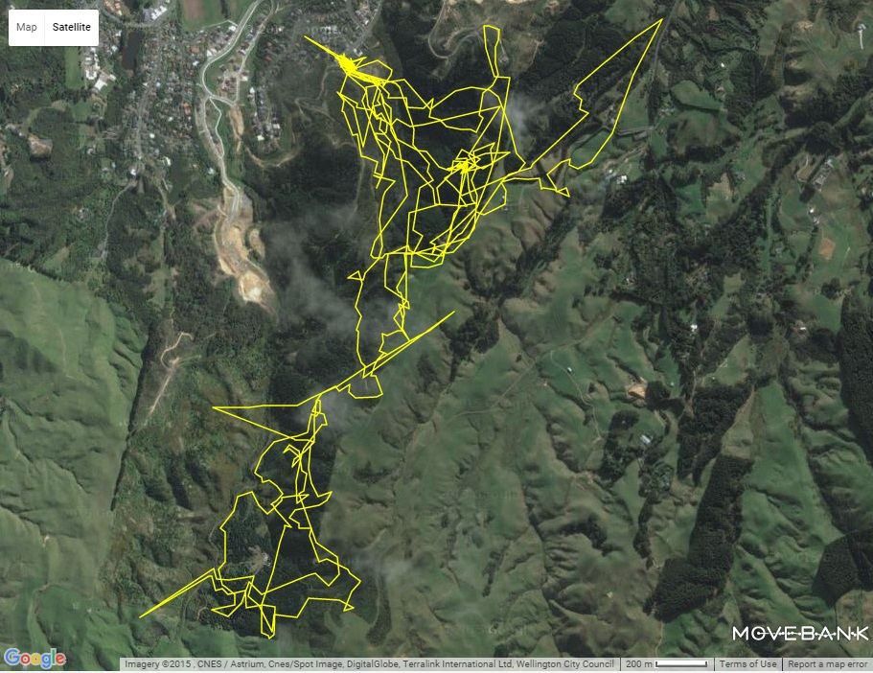
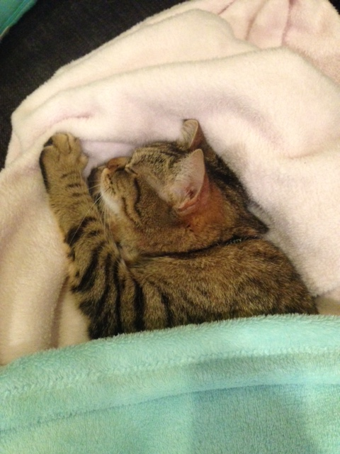

Slide 18
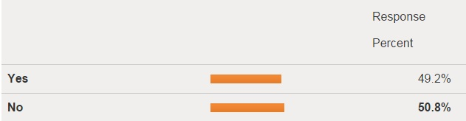
“Do you find roaming cats to be a nuisance?”

Slide 19
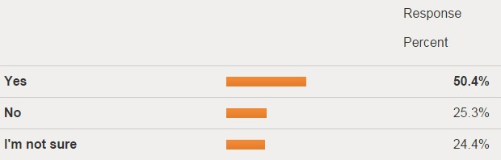
“Do you think cat registration should be mandatory?”

Slide 20
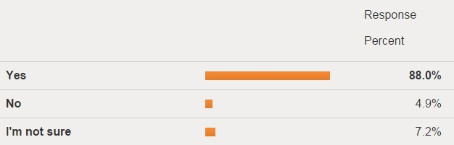
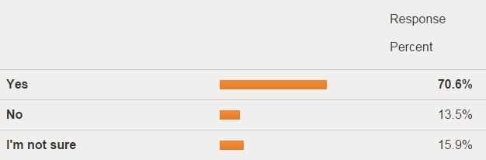
Desexing
Microchipping

Slide 21
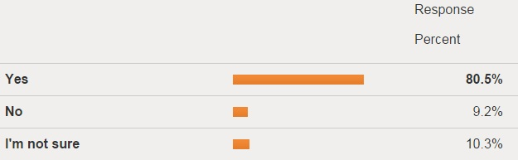
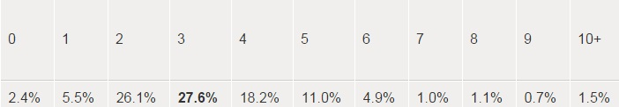
Cat Limit?
How many?

Slide 22
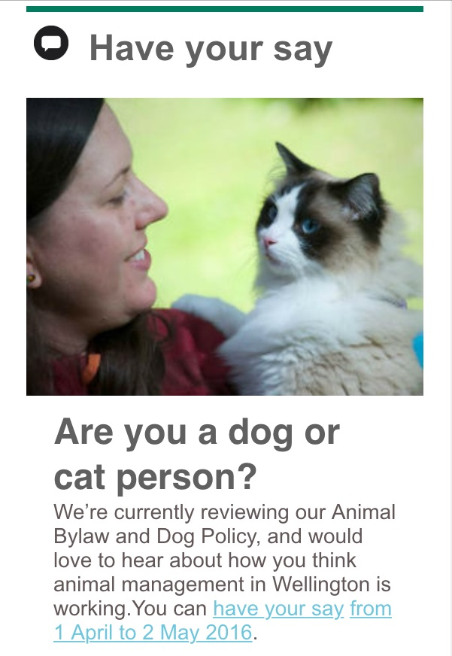
Wellington City Council animal bylaw review - 2016
Microchipping
Permission to own more than 3 cats
Encourage responsible pet ownership

Slide 23






Thanks cattracker.nz@gmail.com

